Slide 1


FULL STACK WEB DEVELOPMENT WITH DJANGO
Lecture 14

Slide 2

Today’s Agenda
Developing Our Django App
Solution Of The Exercise

Slide 3

Exercise
Suppose you have following data extracted from Emp table:
Write a Django App using templates which displays this complete data as shown on the next slide
EmpNo | Ename | Salary | Hiredate
101 | Amit | 50000.0 | August 27,2018
102 | Deepak | 45000.0 | November 29,2018

Slide 4
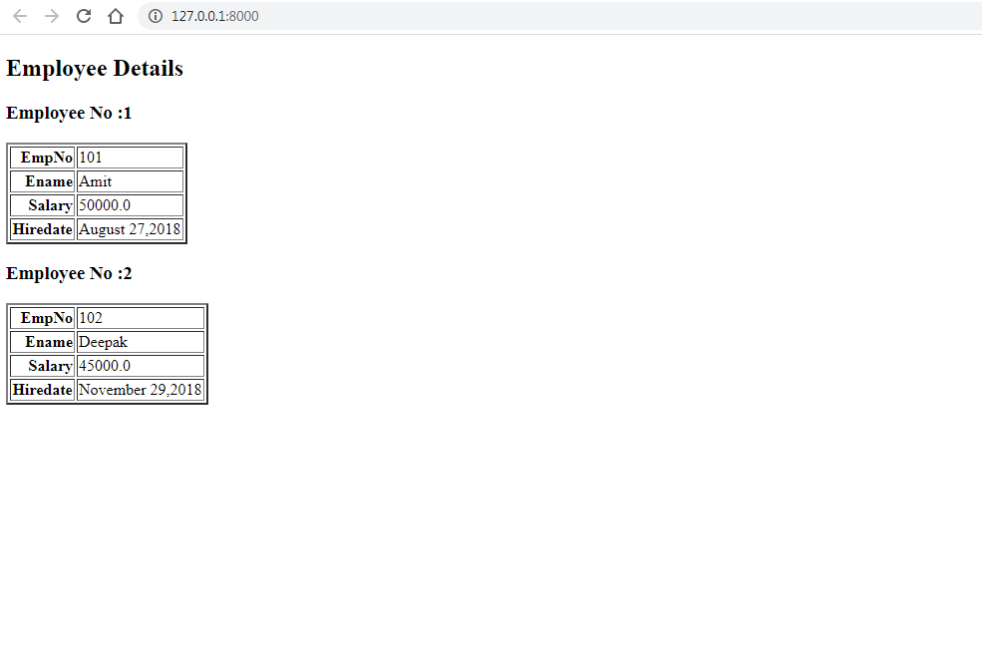
Exercise

Slide 5
Solution
As usual we will , first , setup VS Code and create the project and app as follows:
Open VS Code and open the folder myvsdjangoproject in it
Open the command palette and new terminal to activate django virtual environment
Now create a project called demoproject9 using the usual command django-admin startproject demoproject9
Then create the app by using the command django-admin startapp templateapp
Create a folder called templates in the root folder demoproject9 and within templates create a folder called templateapp

Slide 6
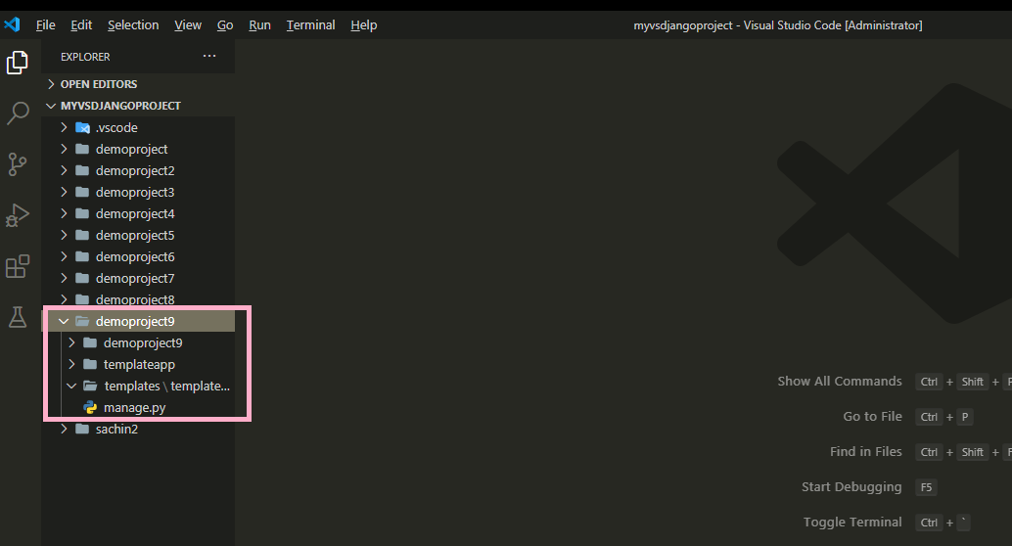
Solution

Slide 7
Solution
After doing all the initial setup in VS Code , the next task is to update the settings.py file by making 2 entries:
Entry for the app in the INSTALLED APPS list
Entry for the templates directory in DIR key of TEMPLATES

Slide 8
Solution
Open the settings.py file in the demoproject9 app of our demoproject9 folder and make the entry shown in green color in the INSTALLED_APPS list
Code:
INSTALLED_APPS = [
'django.contrib.admin',
'django.contrib.auth',
'django.contrib.contenttypes',
'django.contrib.sessions',
'django.contrib.messages',
'django.contrib.staticfiles',
‘templateapp',
]

Slide 9
Solution
In the settings.py of demoproject9 app locate the TEMPLATES list and modify it’s DIR key as shown below in green color:
TEMPLATES_DIR=os.path.join(BASE_DIR, 'templates')
TEMPLATES = [
{ ...
'DIRS': [TEMPLATES_DIR],
... },
]

Slide 10
Solution
Now we have the template in place, we need to update our views.py.
In our views.py file , we must do the following:
Create a List called emp_recs .
This list should contain 2 dictionary objects
Each dictionary object will have 4 key-value pairs , where key will be the DB column name and value will be it’s corresponding value.
Then we should define a function called homePageView() , create a dictionary object called context and place this list object inside our context dictionary with the key name set to records
Then we should call the render() function passing it 3 arguments:
Request object
Template file path assuming that the html file name is showemp.html
Context dictionary

Slide 11
Solution
from django.shortcuts import render
emp_recs=[
{
'empno':101,
'ename':'Amit',
'salary':50000.0,
'hiredate':'August 27,2018'
},
{
'empno':102,
'ename':'Deepak',
'salary':45000.0,
'hiredate':'November 29,2018'
},
]

Slide 12
Solution
def homePageView(request):
context={'records':emp_recs}
return render(request,"templateapp/showemp.html",context)

Slide 13
Solution
Once we’ve done the view and template folder structure then we can create an html file called showemp.html inside of the templates/templateapp3 directory.
This file should display the data from the list , passed by the views.py file , called records using template tags

Slide 14
Solution
#showemphtml
<!DOCTYPE html>
<html lang="en">
<head>
<meta charset="UTF-8">
<meta name="viewport" content="width=device-width, initial-scale=1.0">
<meta http-equiv="X-UA-Compatible" content="ie=edge">
<title>Template Tags Demo</title>
</head>
<body>
<h1>Employee Details </h1>
{% for e in records%}
<h1><u>Employee {{forloop.counter}}</u></h1>
<table border='1'>
<tr><th align='right'>EmpNo:</th><td>{{e.empno}}</td></tr>
<tr><th align='right'>Ename:</th><td>{{e.ename}}</td></tr>
<tr><th align='right'>Salary:</th><td>{{e.salary}}</td></tr>
<tr><th>Hiredate:</th><td>{{e.hiredate}}</td></tr>
</table>
{%endfor%}
</body>
</html>

Slide 15
Solution
After creating and updating the views.py we need to tell Django this is the view we want displayed when someone navigates to the site root (home page).
As usual we do this by configuring our URLs at 2 places:
Inside the templateapp directory’s urls.py file
Inside the site’s main urls.py

Slide 16
Solution
In the VS Code create a new file called urls.py in the templateapp folder and write the following code in it.
Code (templateapp/urls.py):
from django.urls import path
from . import views
urlpatterns = [
path('', views.homePageView),
]

Slide 17
Solution
As we know whenever a request arrives it first hits the main urls.py file , that is , the file urls.py in the directory demoproject9
So we must configure this file also so that it simply redirects the request to our templateapp3 urls.py file whenever a request arrives

Slide 18
Solution
In the VS Code open the file called urls.py in the demoproject9 folder and update the code in it as shown below in green.
Code (demoproject9/urls.py):
from django.contrib import admin
from django.urls import path,include
urlpatterns = [
path('admin/', admin.site.urls),
path('',include('templateapp.urls')),
]

Slide 19
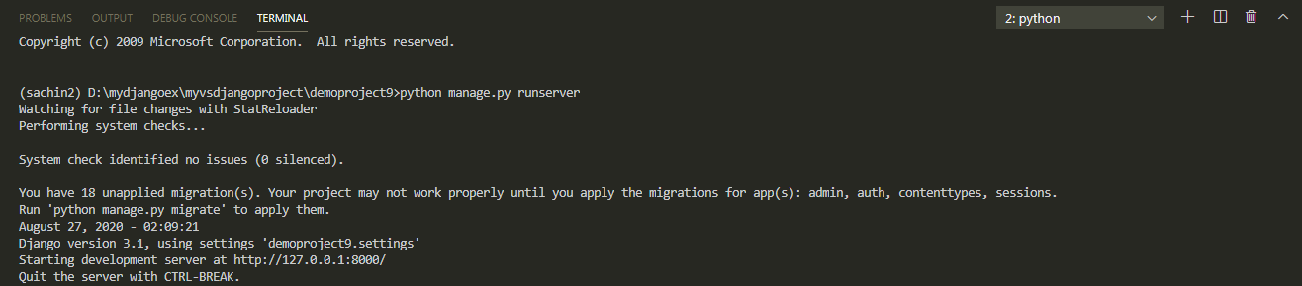
Solution
To run our new templateapp , go to the folder demoproject9 by using cd command and type the runserver command in VS Code terminal
cd demoproject9
python manage.py runserver.
The server runs on the default port 8000, and we’ll see output like the following output in the terminal window:

Slide 20
Solution
Ctrl+click the http://127.0.0.1:8000/ URL in the terminal output
window to open default browser to that address. Now we should
see the employee data as a template based home page

Slide 21
Exercise
Modify the app in such a way that if a title variable is passed from the view , then the page shows it as the title otherwise it should display the title “Template Tags Demo”

Slide 22
Solution
Everything will remain same except 2 changes
We will have to update the view so that it now sends a key called title in the context with the value “Staff Details” .
In the HTML file we will have to use default filter for either setting the title as the value of the variable title or setting it to Template Tag Demo , if the title variable is not passed

Slide 23
Solution (views.py)
....
….
def homePageView(request):
context = {"records": emp_recs,'title':'Staff Details'}
return render(request,'templateapp/showemp.html',context)

Slide 24
Solution(showemp.html)
<!DOCTYPE html>
<html lang="en">
<head>
<meta charset="UTF-8">
<meta name="viewport" content="width=device-width, initial-scale=1.0">
<meta http-equiv="X-UA-Compatible" content="ie=edge">
<title>{{title|default:"Template Tag Demo"}}</title>
</head>
<body>
....
….
</body>
</html>

Slide 25
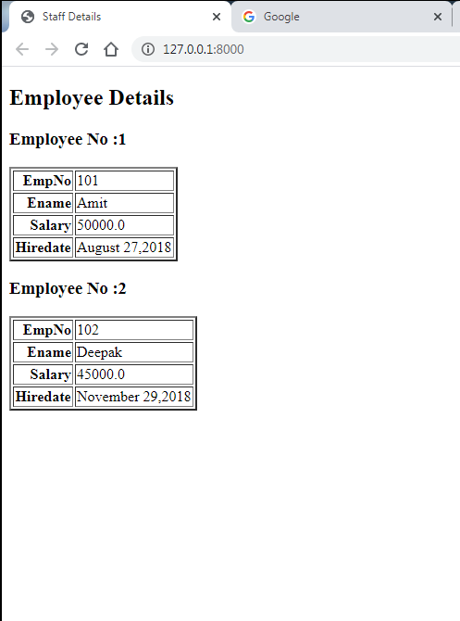
Solution
Ctrl+click the http://127.0.0.1:8000/ URL in the terminal output
window to open default browser to that address. Now we should
see the title as Staff Details

